Slide 1
Value Based Reimbursement: Financial and Operational Considerations
October 12, 2016

Slide 2
Today’s Discussion
Welcome and Introductions
The Primary Care Value Equation
What are Value Based Reimbursements?
Common Financial and Operational Strategies
Q&A

Slide 3
Welcome and introductions

Slide 4
… Who We Are
Starling Advisors works nationally with Safety Net Providers, with a specific focus on Health Centers, Networks of Health Centers, Primary Care Associations, and the National Association of Community Health Centers to answer the question:
“What changes, if any, do we need to make to insure a role in providing high-quality, comprehensive primary care under Health Reform?”
Partner To
Grantee
Funded By

Slide 5
The primary care value equation

Slide 6
What is Value?
Outcomes
=
x
x
Value
Risk
Scale
Cost^{(us)} + Cost^{(them)}
Copyright, Starling Advisors LLC, 2015. All rights reserved.
Value. Quantifiable, monetary benefit your care provides to a payer’s patients.

Slide 7
What is Value?
Outcomes
=
x
x
Value
Risk
Scale
Cost^{(us)} + Cost^{(them)}
Copyright, Starling Advisors LLC, 2015. All rights reserved.
Outcomes. Measurable indicators of population health which demonstrate effectiveness of your care model.

Slide 8
What is Value?
Outcomes
=
x
x
Value
Risk
Scale
Cost^{(us)} + Cost^{(them)}
Copyright, Starling Advisors LLC, 2015. All rights reserved.
Cost^{(us)}. The cost of the care you deliver to patients, and the relative efficiency of this care. For example, keeping a population of patients with diabetes healthy using less visits and more telephonic follow up will be considered more efficient than using more visits.

Slide 9
What is Value?
Outcomes
=
x
x
Value
Risk
Scale
Cost^{(us)} + Cost^{(them)}
Copyright, Starling Advisors LLC, 2015. All rights reserved.
Cost^{(them)}. The cost of the care provided to your patients that is delivered outside of your organization. Also referred to as cost effectiveness. When a population of patients uses less inpatient days than projected, the cost effectiveness of your care is considered to be higher.

Slide 10
What is Value?
Outcomes
=
x
x
Value
Risk
Scale
Cost^{(us)} + Cost^{(them)}
Copyright, Starling Advisors LLC, 2015. All rights reserved.
Risk. A measure of the impact of certain factors on cost of care. For example, a population with high incidence of chronic disease has more underlying risk than a population of patients with no chronic diseases. Your value is impacted by your ability to identify and address these risk factors.

Slide 11
What is Value?
Outcomes
=
x
x
Value
Risk
Scale
Cost^{(us)} + Cost^{(them)}
Copyright, Starling Advisors LLC, 2015. All rights reserved.
Scale. Your ability to deliver a consistent care model to a large, and increasing population of patients. Scale also includes the concept of access, which is the ability to deliver care in a timely fashion without unnecessary delays.

Slide 12
The Financial Challenge
Forecasting:
Can we accept the risk? Even if its “upside only?” How much can we accept?
How will it impact cash flow, profitability, and our need for financial reserves?
Budgeting:
With so many new competencies, how can we make smart investments?
What new services, staff, and infrastructure do we need to be successful?

Slide 13
The Operational Challenge
Care team models
How will staffing change to support Value Based Reimbursements?
Care Coordination
How do we create the necessary capabilities to address value?
The Data-Driven Health Center
How do we propagate data and information throughout the Health Center’s operations?

Slide 14
Introduction to value based reimbursement

Slide 15
Case Study: Value Based Reimbursement
I will pay you $200 per member per month for each of your patients with Diabetes, to provide them with the care that they need.
Is this a good deal? Would you take it?

Slide 16
Discussion: Value Based Reimbursement
Scope: What services need to be covered by the payment?
Severity: Is the payment reasonably adjusted for the actual severity mix of my health centers diabetes population?
Baseline: What were the costs of the same services over the previous six to twelve months?
Relationship: What formal or informal relationships do I need to effectively utilize that budget?
Infrastructure: What data systems and management tools and processes do you need to make this work?

Slide 17
What are Value Based Payments?
Value-based payments come in a variety of styles. Here are a few common ones:
Quality incentives – set payments made for achievement of certain quality goals
Shared savings – a portion of savings against total medical expense are shared with the provider
Bundled payments – a single payment that must cover all services for a patient for a specific medical event
Full or partial capitation – a single payment that must cover all services for a patient over a given time period

Slide 18
What are Value Based Payments?
To provide comprehensiveness in healthcare delivery, you must receive premium payments. To receive premium payments in the future, you must bear financial risk.
Increasing risk,
Increasing reward
Cost-based
Shared-savings
Partial capitation
Fee-for-service
Global payments
Full
capitation

Slide 19
Understanding Value Based Payments
Pure Fee For Service
Before entering Value Based Payment Models, most organizations derive 100% of their compensation on a Fee for Service Basis.
Common financial challenges:
Can I keep my cost per service below my reimbursement?
Can I drive adequate volume through my care model to offset overhead?
100%
Fee for Service Infrastructure Earned Incentive

Slide 20
Understanding Value Based Payments
Pure Fee For Service
Care Coordination / PCMH
Some “transitional” models pay for care coordination or “Medical Home” infrastructure through additional infrastructure payments.
Common financial challenges:
Can I pay for the people and systems I need with these additional payments?
What will be expected in the future?
How long will this last?
10%
100%
100%
Fee for Service Infrastructure Earned Incentive

Slide 21
Understanding Value Based Payments
Pure Fee For Service
Care Coordination / PCMH
P4P
Classic “Pay for Performance” models offer upside-only rewards for achieving certain clinical or other population health goals.
Common financial challenges:
How do I budget for programs to achieve these incentives?
If I fail to meet these incentives, how will these added costs impact us?
10%
10%
100%
100%
100%
Fee for Service Infrastructure Earned Incentive

Slide 22
Understanding Value Based Payments
Pure Fee For Service
Care Coordination / PCMH
P4P
True Value Based
Ultimately, the type of Value Based payments most payers will seek involve some downside with the opportunity to earn substantial upside.
Common financial challenges:
How do I bear losses if I do not earn incentives?
Will I have the cash-flow to endure each performance period?
30%
10%
10%
100%
100%
100%
90%
Fee for Service Infrastructure Earned Incentive

Slide 23
FINANCIAL AND OPERATIONAL STRATEGIES

Slide 24
FFS + Care Coordination
Characteristics:
No change in base reimbursement.
Additional payments made to cover cost of care coordination services.
Care coordinators focus on high risk patients whose outcomes and costs can be impacted through ”alternative touches.”
Not a true “Value Based” payment methodology, because it does not vary payments based on outcomes.
Examples:
2703 Health Home initiatives.
Missouri Primary Care Health Home pays $58.87 per member, per month for care managers, behavioral health consultants, and care coordination and administration.¹
Managed Care Contracts.
1 http://www.nashp.org/missouri/

Slide 25
FFS + Care Coordination
Forecasting:
Use EHR data to predict total number of patients who will qualify for the payments.
Estimate costs for staffing to support care coordination model, including standard overhead.
Estimate costs for additional IT and administrative support.
Determine staffing levels such that costs do not exceed revenues.

Slide 26
FFS + Care Coordination
Item | Cost/Revenue
Eligible patients | 1,000 x $58.87PMPM = $58,870 / mo. = $706k / yr.
Capital investments in Health IT | $250,000 allocated over 2 years = $125k / yr.
Administrative support costs | $100k / yr.
REMAINDER | $481k / yr.
Fully loaded cost per care coordinator | $48k / yr.
Staffing ratio | $481k / $48k = 10 care coordinators = 1:100 patients
If the staffing ratio is realistic, then FFS + Care Coordination is a good transitional model. Make sure to consider sustainability of the program as the model transitions to true value-based.

Slide 27
Pay for Performance
Characteristics
No change in base reimbursements.
Additional payments made when achieving certain levels of performance against a pre-defined set of indicators.
Despite no contracted downside, these models have indirect downside risk.
Staffing and infrastructure are usually lower than a care coordination model.
Examples
Medicare Hospital Value-Based Purchasing (VBP)¹
Many Medicaid Manage Care programs
1 https://www.cms.gov/Medicare/Quality-Initiatives-Patient-Assessment-Instruments/hospital-value-based-purchasing/index.html

Slide 28
Pay for Performance
Forecasting:
Clearly identify which patients qualify for which payments:
Are payments for the whole attributed population or only those in the denominator of key measures?
Determine total potential payout, and whether partial payments are possible.
Estimate costs for staffing focused on pay for performance measures.
Estimate costs for additional IT and administrative support.
Determine staffing levels to support attainment.
NOTE: Pay for performance has indirect downside risk. Failure to attain goals leads to a net loss.

Slide 29
Pay for Performance
Item | Cost/Revenue
Eligible patients | 4,000 x $4PMPM (50%) or $8PMPM (100%) = $ 192k to $384k per year
Capital investments in Health IT | N/A - utilize existing EHR and reporting capabilities
Administrative support costs | $30k / yr.
REMAINDER | $152k to $344k / yr.
Fully loaded cost per data analyst / P4P specialist | $60k / yr.
Staffing ratio | 2 dedicated P4P staff with a cost of $120k + $30k would be fully at risk unless 50% of goals met. $194k gain if 100% realized.
The organization must decide if clinical goals are realistic and attainable, and staff accordingly.

Slide 30
Sidenote: Cost of Care
All of the remaining models include the concept of “Cost of Care” (CoC) although each applies this slightly differently.
CoC is defined as the sum of all of the payments made by a payer for a given patient or population, for a given time, for a defined set of services.
For example, CoC could include all professional, facility, drug, and durable medical goods expenditures.
When compared to our Value Equation, CoC = Cost^{(us)} + Cost^{(them)}

Slide 31
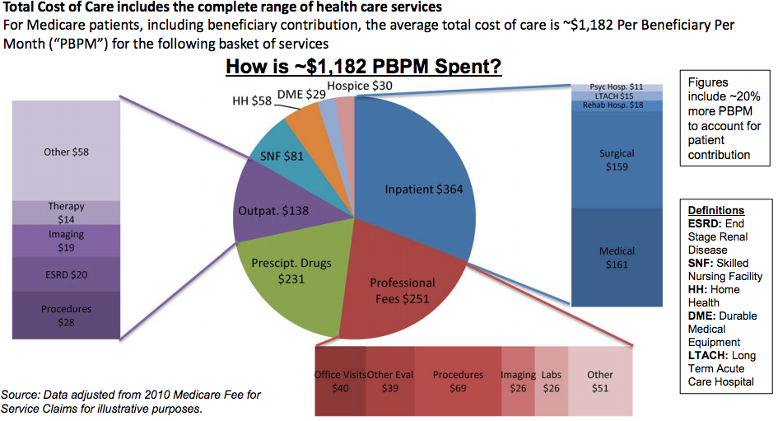
Sidenote: Cost of Care
Medicare generally includes all services it reimburses when considering cost of care.
This illustration shows a breakout for the total Medicare FFS enrolled population.
Source: https://innovation.cms.gov/files/slides/health-care-innovation-challenge-webinar-3-slides.pdf

Slide 32
Shared Savings
Characteristics
No change in base reimbursements.
A portion of savings derived against a financial benchmark are shared with the provider. The financial benchmark is usually derived from “Total Cost of Care” from previous years.
No base payment downside, but cost overruns can be withheld from future base payments (known as a “two-sided risk model.”
Wide variability in staffing options.
Examples
Medicare Shared Savings Program for ACOs¹
Many Medicaid Manage Care programs
1 https://www.cms.gov/Medicare/Medicare-Fee-for-Service-Payment/sharedsavingsprogram/index.html

Slide 33
Shared Savings
Forecasting:
Requires firm attribution, usually tied to historical relationship with patient.
Historical costs and actuarial methods determine a “cost benchmark.”
Often, a “minimum savings rate” is applied before shared savings are accrued.
Providers are paid a portion of the savings.
Usually has P4P-like measures that determine if payments are made.
The Healthcare Payment and Learning Action Network has guidance on establishment of cost benchmarks: https://hcp-lan.org/groups/pbp/fb-final-whitepaper/

Slide 34
Shared Savings
Item | Cost/Revenue
Eligible patients and predicted costs | 10,000 @ $4,500 expected cost per year = $45M
Minimum savings rate 2% (illustrative) | 2% of $45M = $900k
2% savings 3% savings 4% savings 6% savings | $900k = $0 shared savings pool $1.35M = $450k shared savings pool $1.8M = $900k shared savings pool $2.7M = $1.8M shared savings pool
50% paid to provider, assuming P4P measures hit | $225k - $900k / yr.
COSTS (covered in budgeting module) | $375k / yr.
NET | ($150K) - $525k / yr.
The organization must decide if clinical goals are realistic and attainable, and staff accordingly.

Slide 35
Strategies
Component of the Value Equation | Strategies
Outcomes | Budget for systems to measure outcomes, costs, and risk.
Cost^{(us)} | Evaluate and improve cost efficiency. Understand unit cost per encounter or per-member, per-month.
Cost^{(them)} | Evaluate and understand total cost of care, and introduce into management level discussions.
Risk | Implement NACHC PRAPARE¹ or similar tools to better quantify social determinants of health.
Scale | Plan for growth (scale), particularly care teams.
1 http://nachc.org/research-and-data/prapare/

Slide 36
Recap
All value-based purchasing programs require common elements:
Capital investment on behalf of the provider
Staffing for care coordination
Analytics to improve awareness of opportunities and to prioritize work
Higher risk models require deeper skills, some of which must be resourced externally:
Shared Savings and Capitation require understanding of Total Cost of Care and may require actuarial analysis of underlying data.
Strong partnership between financial leaders and clinical leaders are necessary to make any of the models work.

